Slide 1
Risk Game
SOEN 6441 – Build 2
Team 7 Members: Meng Yao, Jaspreet, Somayeh Abedi, Ramit Basra

Slide 2
Agenda
Architecture
Demonstration
Members’ division of labor

Slide 3
Architecture Design
This Game implements Model-View-Controller for Map Editor & Entire Game Play
We have used observer pattern for deploying MVC design.

Slide 4
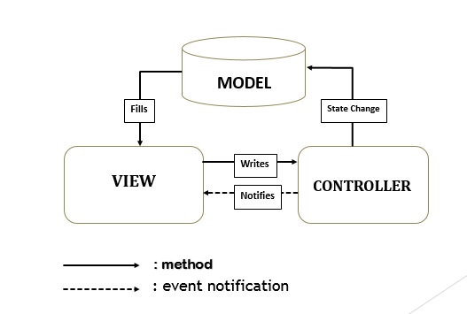
Architecture
Figure: Architecture Design for Risk Game

Slide 5
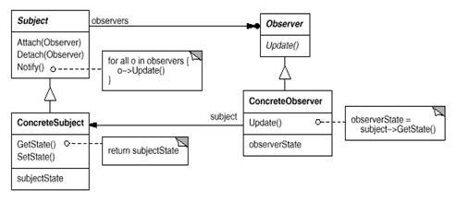
Design Patterns
Observer
Observer pattern is used when there is one-to-many relationship between objects such as if one object is modified, its dependent objects are to be notified automatically.
Example: adding or losing territories, exchanging cards, etc.

Slide 6
Design Patterns
Singleton
The singleton pattern restricts the instantiation of a class to one object. This is useful when exactly one object is needed to coordinate actions across the system .
This instance is created when the program starts, and can only be accesses through the public getInstance() method.

Slide 7
Model Layer
Entire classes & objects
createNewMap ():
i)user enters country name
ii) coordinates(x and y)
iii) adjacent countries.
All this, is handled using try catch block. This also verifies the correctness of map.
Buffered i/o is used to write and read the data from memory.

Slide 8
Model Layer
Risk_Model (): extends Observable and (i)loads board (ii) initialize game (iii) random allocation of turns (iv) skipping turns (v) get list of cards and countries (vi) reinforce and (vii) fortify.
setPlayerCount() and getPlayerCount() to set and get the value of players.
Player(): getArmies(), getOwnedCountries, turnInCards(), decrementArmies(), incrementArmies(), addRiskCard(), removeCards()
loadBoard (): loads the board from three files i.e. countries file, continent file and adjacency of countries file.
CountryLabel() and RiskListModel() : extends Observer and update countries, adjacency and occupied countries per player turn.

Slide 9
View Layer
Customer View: MapEdit_View ,RiskStart_View, BoardView, PlayerCount_View, PlayerSetting_View, MenuView, LoadMap_View.
Awt: Dimension, GridLayout, BufferedImage, BorderLayout, FlowLayout
Swing: JComponent, JButton, JDialog, JFrame, Jpanel, JComboBox, JTextField, Box.

Slide 10
View Layer Core Classes for Displaying
BoardView():
i) messagePanel(): to display cards and turn-ins
ii)actionPanel(): allows the user to perform actions.
iii)countryInfoPanel(): show info related to countries and continents.
MapEdit_View():
i) add and remove countries.
ii) delete continents.
PlayerCount_View(): Player number selection
PlayerSetting_View(): takes player name

Slide 11
Controller Layer
User Input and manipulation
ActionListener interface: loadmap.addActionListener(), turnInBtn.addActionListener(), btnnewMap.addActionListener(), reinforceBtn.addActionListener(), fortify.addActionListener() endturn.addActionListener().
ListSelectionModel interface: addListSelectionListener().
ActionEvent: a semantic event which indicates that a component-defined action has occurred.
ActionEvent: getActionCommand(), actionEvent.equals().

Slide 12
Controller Layer
ListSelectionEvent : getValueIsAdjusting().
Java.util.Scanner: take user inputs from System.in.

Slide 13
Coding Standards
Packages: Java package for each self-contained project or group of related functionality. Create and use directories in accord with java package conventions.
Naming:
Class Name: XxxXxxx， Xxx_Xxxx (eg: CountryMap);
Property/method : xxXxxx (eg: addCountry);
Spacing:
Between Keywords: int a = b + c;
Between Paragraph: Code in method should be split base on logic group:
//some code based on logic A
//some code based on logic A
//some code based on logic B
//some code based on logic B

Slide 14
Coding Standards
3. Between Parameters: Start a new line when there are so many parameters in a function.
Returning are based on the logic:
grid (int width, int height,
String name)
Braces:
Position: xxxx xxxx {
xxxx
}
2) Fully:
if (xxx){
xxxx
} else if (xxx) {
xxxx
}else{
xxxx }

Slide 15
Coding Standards
Comments:
Types:
Javadoc:
/**
Method Description
@para a a
*/
Inside Method:
// this is for xxxx
Inside Method:
Comment should be before the code it explain, and place at least one empty line above the comment:
xxxxx.xxxxx();

Slide 16
Coding Standards
Other
Access Control: Any functions or properties you want to use but are not listed in the Class Diagram, should be marked as private.
Sample Code: See RiskApp.java

Slide 17
Members Division of Work
Map Editor: Jaspreet ,Somayeh Abedi, Meng Yao
Game Play: Meng Yao
Startup Phase:
Reinforcement & Fortification Phase: Yao Meng
Architectural Design & API Documentation:
Unit Testing: Yao Meng

